Slide 1
Back Yard Project
Group 4
Charles Daughters
Christopher Goff
Priscilla Hernandez
Edward Hesson
Matthew Patthey

Slide 2
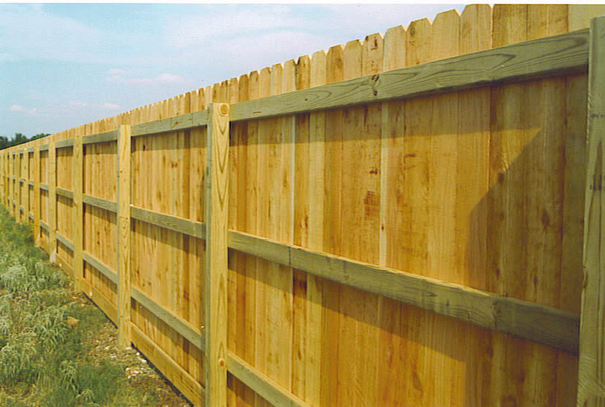
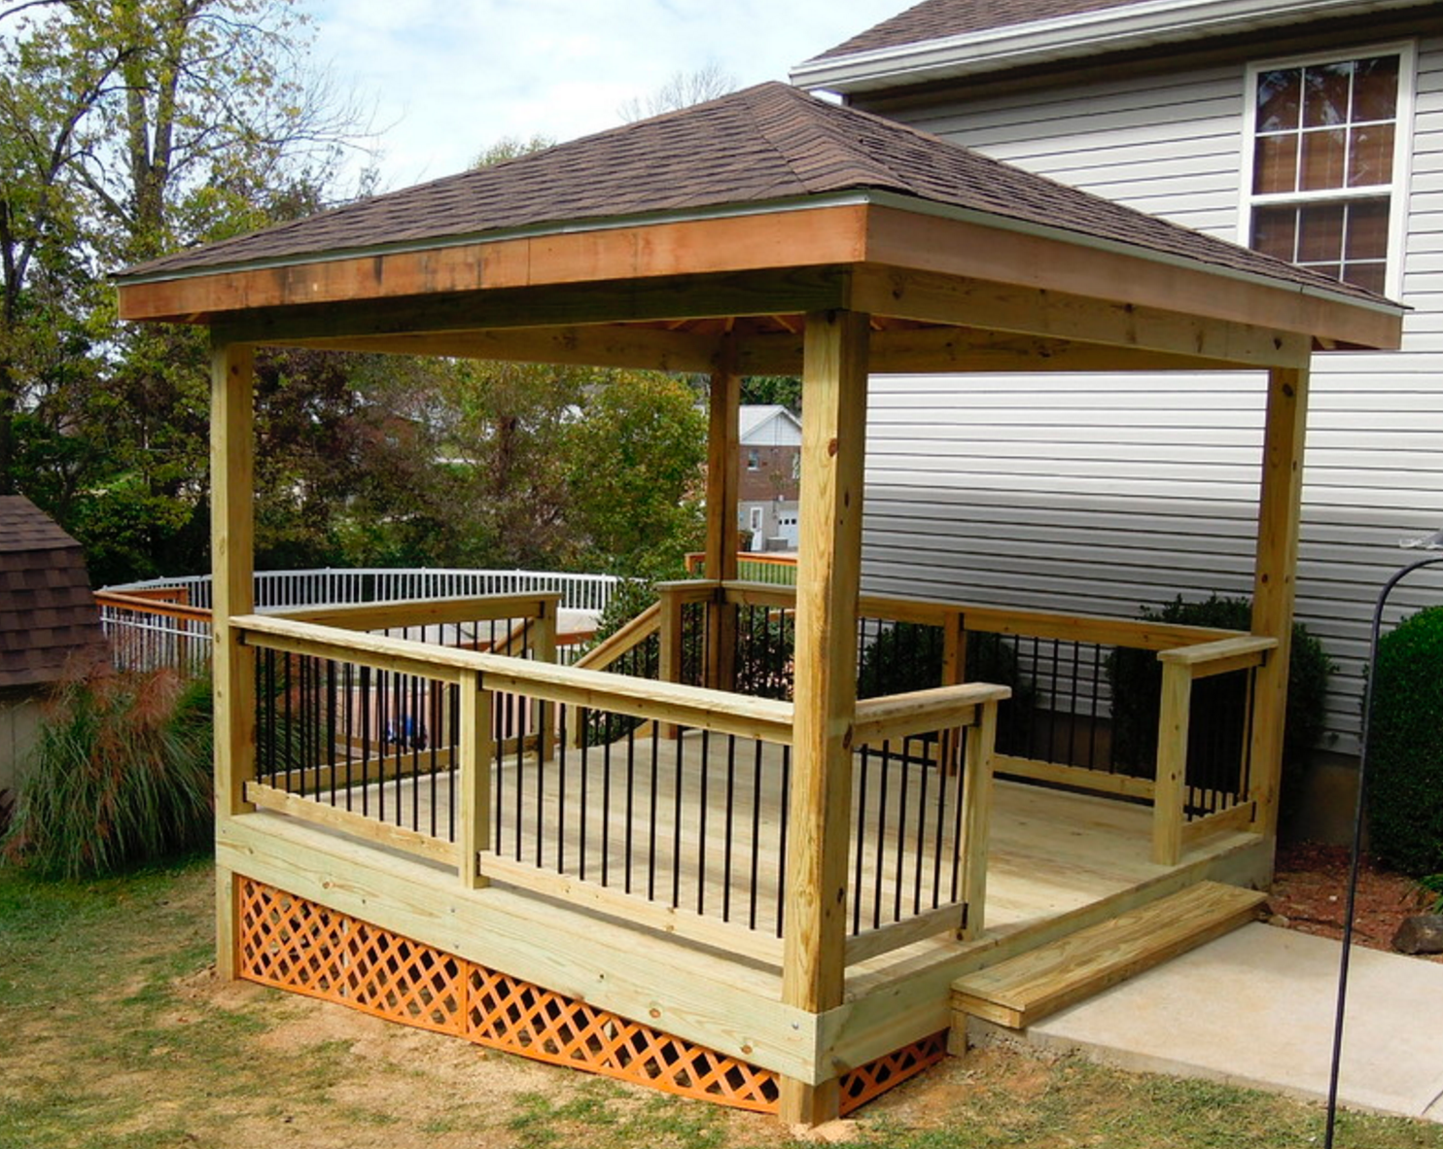
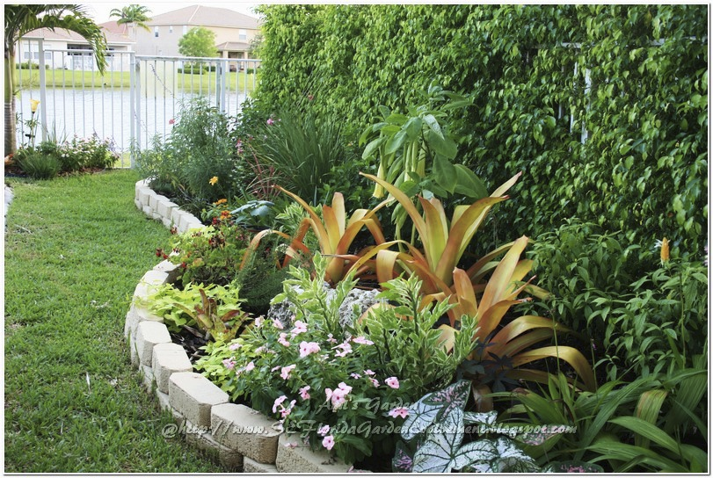
Deliverables
Fence
Deck
Flower Bed

Slide 3
Time Line
Start: MMM DD, YYYY
End: MMM DD, YYYY

Slide 4
Costs
Tools $x,xxx.xx
Fence $x,xxx.xx
Deck $x,xxx.xx
Flowerbed $x,xxx.xx
Total $x,xxx.xx

